Slide 1
Mastering System Design
Section 2: System Design Fundamentals
Networking & Communication

Slide 2
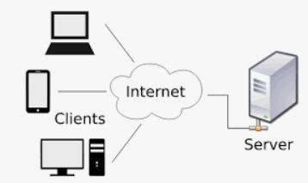
Why Networking Matters in System Design?
Every system relies on data exchange between components
Networking enables scalability, reliability, and performance
Key areas where networking plays a crucial role:
  Communication: Ensuring smooth data transfer between clients, servers, and databases
  Load Balancing: Distributing traﬃc eﬃciently to prevent overload on a single server
  Security: Protecting data from unauthorized access and cyber threats
  Eﬃciency: Optimizing network performance to reduce latency and improve user experience

Slide 3
How Networking Impacts Large-Scale Systems
Helps handle millions of users concurrently
Enables fast and eﬃcient data exchange
Reduces latency & improves system resilience
Essential for cloud computing & distributed systems

Slide 4
Agenda: Key Networking Concepts in System Design
Understanding IP Addresses
How DNS Works
Client-Server Model Explained
Forward Proxy vs. Reverse Proxy
Introduction to Load Balancing
What is an API Gateway?
Content Delivery Networks (CDN) in System Design

Slide 5
Wrap-Up & What’s Next
Networking is the foundation of system design
Next, we’ll deep dive into networking components
Coming up: IP Addressing & DNS

